Slide 1
Sequence Alignment
MODULE 2, CS010 804L3 Bioinformatics
Girish Balakrishnan
Assistant Professor, CSE, MITS

Slide 2
Part 1 - MOTIVATION

Slide 3
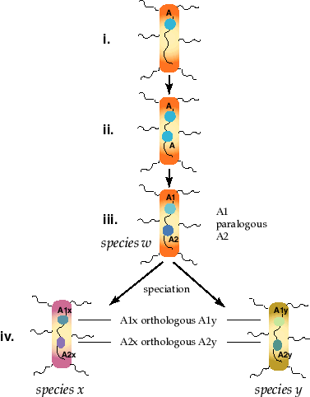
Homology

Slide 4
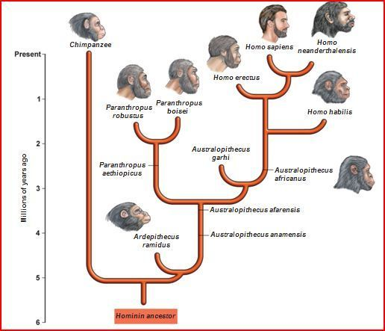
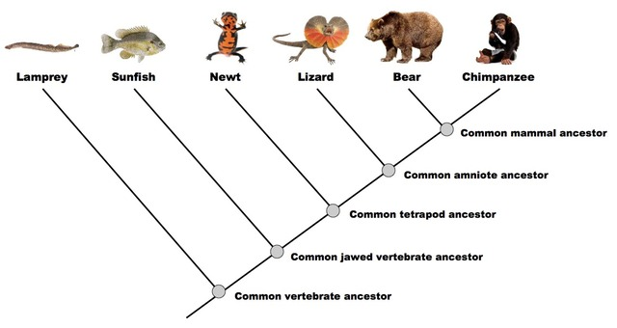
Phylogenetic Tree

Slide 5
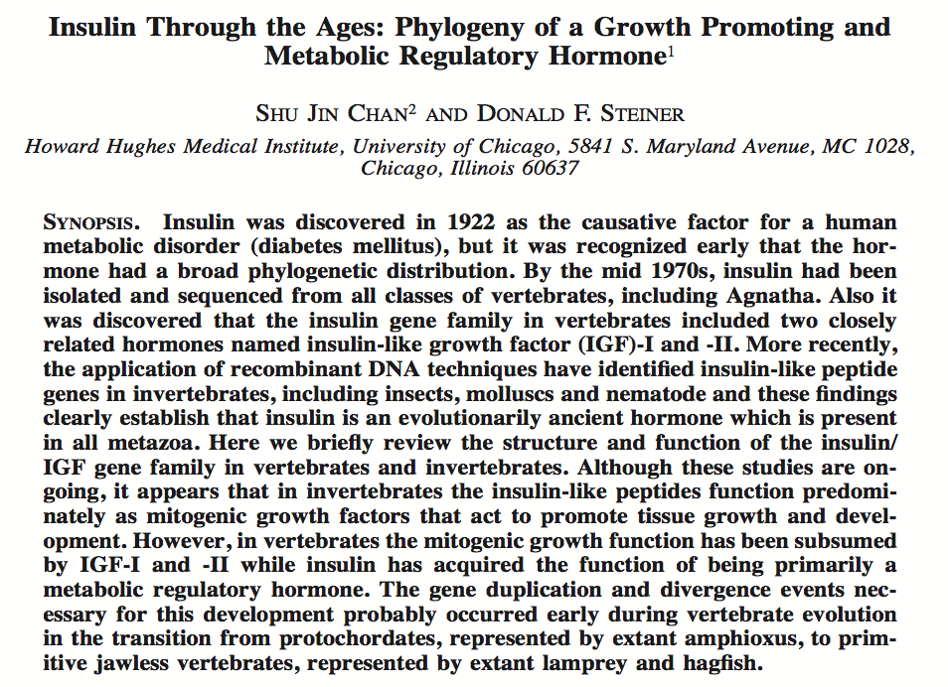

Slide 6
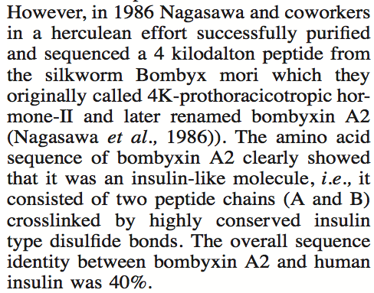
Finding insulin like molecules

Slide 7
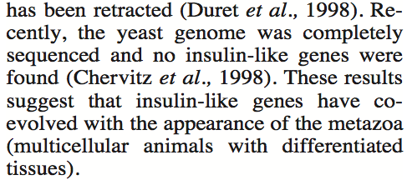
Origins of insulin

Slide 8
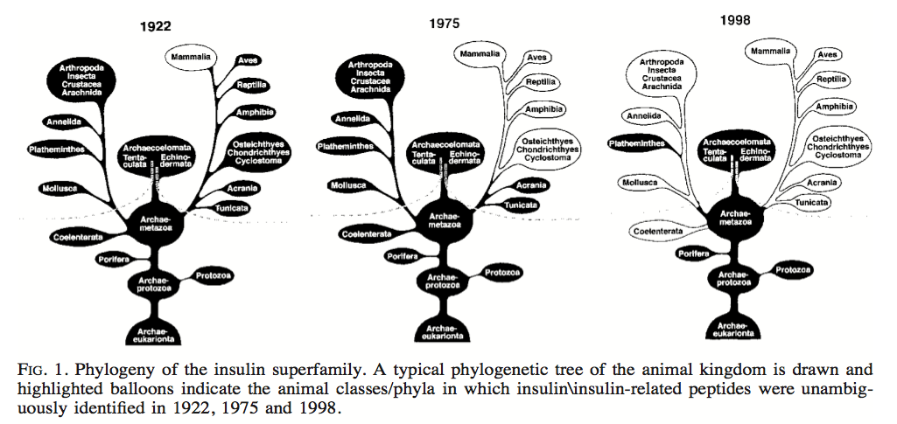
Phylogeny of insulin superfamily

Slide 9
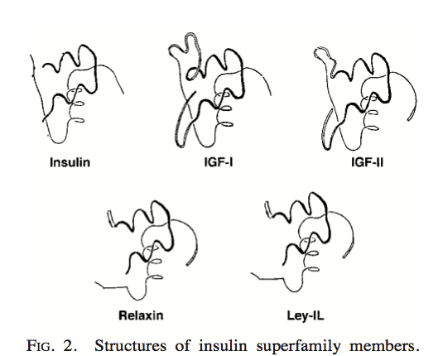
Structures of insulin superfamily

Slide 10
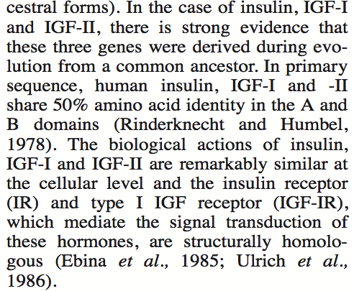
Common ancestor – Insulin and IGF-I

Slide 11
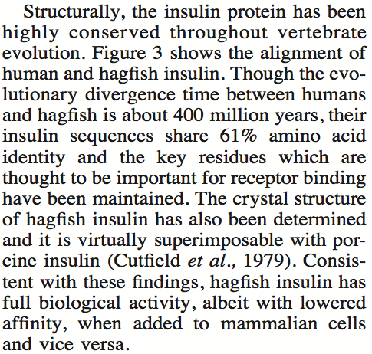
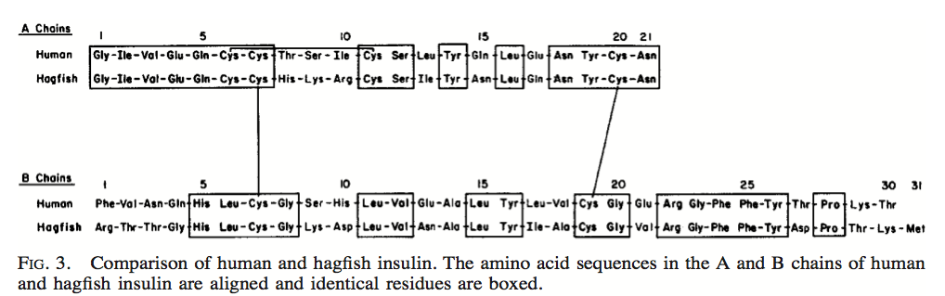
Insulin – A Conserved Protein

Slide 12
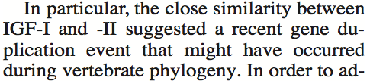
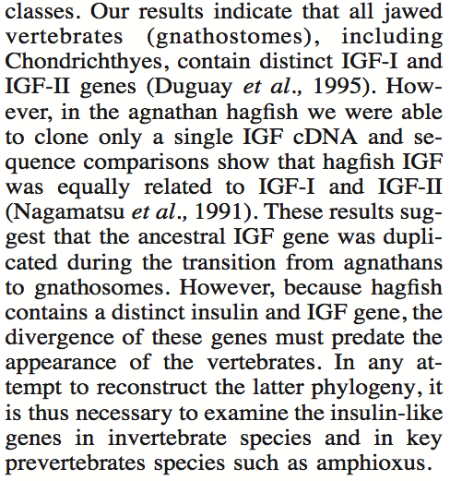
IGF-I and IGF-II Gene Duplication

Slide 13
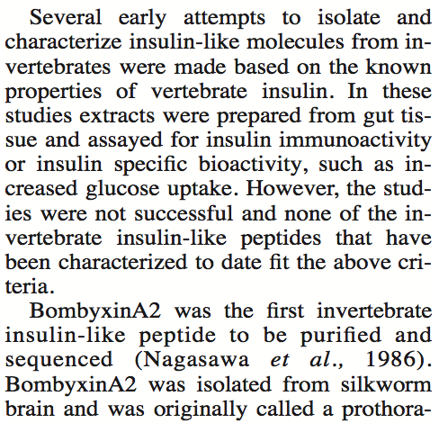
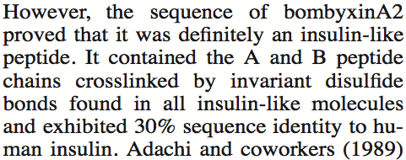
Finding insulin in invertebrates

Slide 14
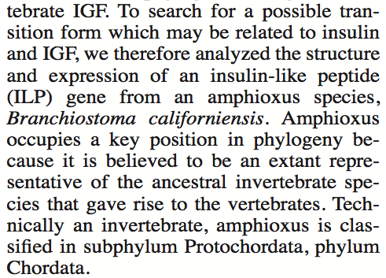
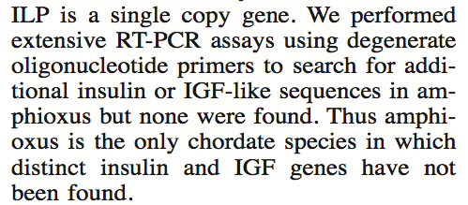
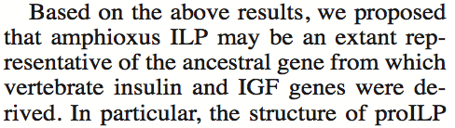

Amphioxus ILP

Slide 15
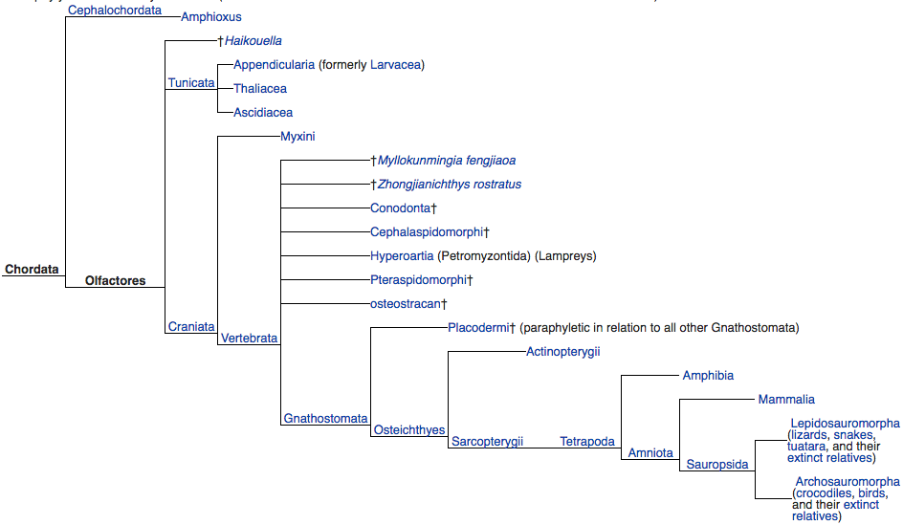

Slide 16
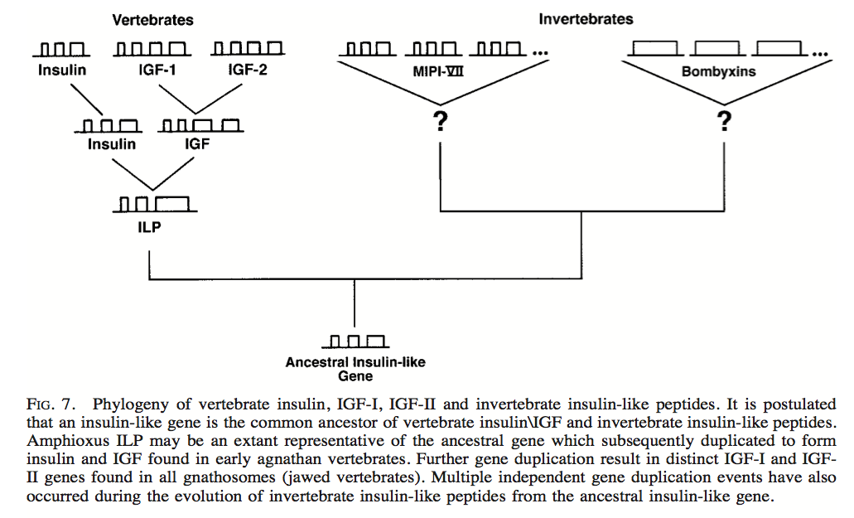
Phylogeny of Vertebrate Insulin
gnathostomes
silkworms
hagfish
Amphioxus
1. Paralogous?
2. Orthologous?

Slide 17
Part 2 – BLAST
Basic Local Alignment Search Tool

Slide 18
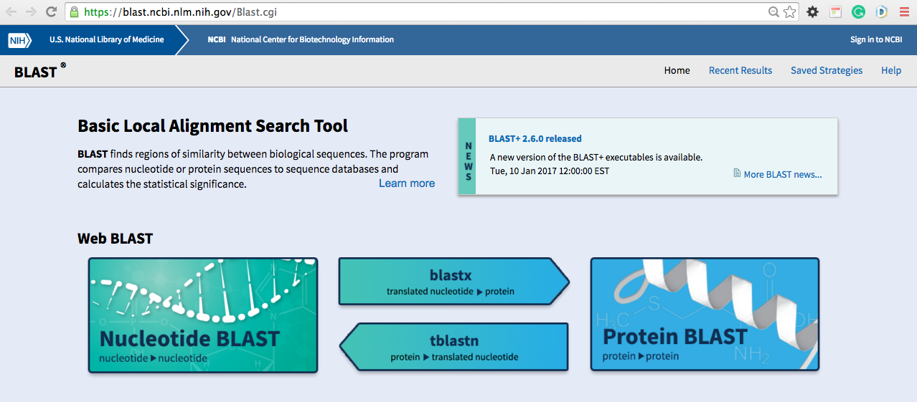
BLAST @ NCBI
There are several BLAST programs like BlastN, BlastP, BlastX, TBlastN and TBlastX

Slide 19
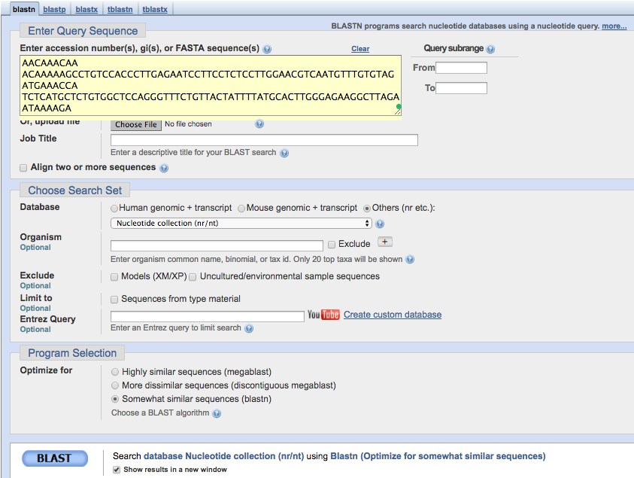
NCBI BLASTN

Slide 20
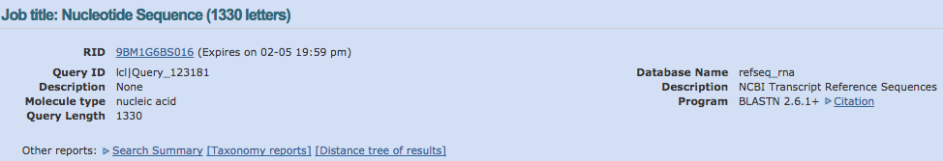
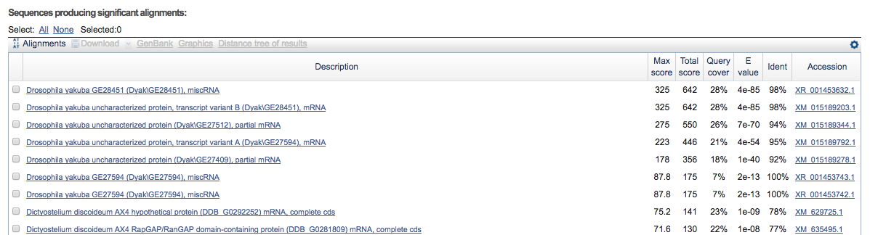
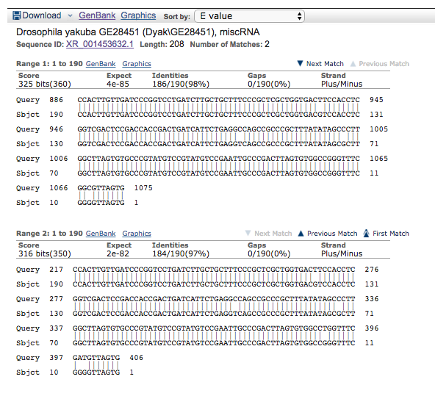
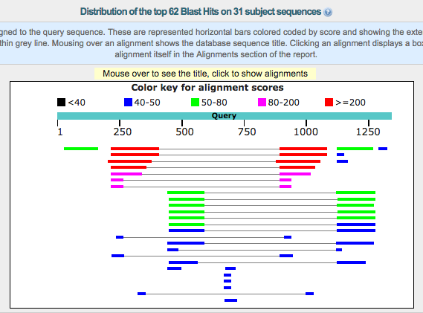
BLAST Report

Slide 21
Aim of BLAST Search
Alignments should make “biological sense”
Check if sequences are evolutionary products
Evolutionary products differ from products of chance
What are products of chance
  Real but non-homologous sequences
  Real sequences that are shuffled to preserve compositional properties
  Sequences that are generated randomly based on DNA or protein model

Slide 22
Null Hypothesis
First step to statistical tests – Identify Null Hypothesis
Null Hypothesis – Assume there is no pattern (here homological) and what you have got is purely random (by chance!)
Z-scores: Measures standard deviation
P-scores: Probability that you have falsely rejected null hypothesis
What do think of a pattern that is associated with very high or very low Z-score and very small P-value?

Slide 23
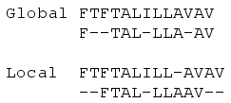
First what is sequence alignment?
Local alignment
  BLAST
  Better for detecting conserved regions in sequences
Global alignment
  Global Alignment tool from NCBI
  Better for structural comparison of two sequences
Pairwise alignment
Multiple alignment
  Clustal Omega

Slide 24
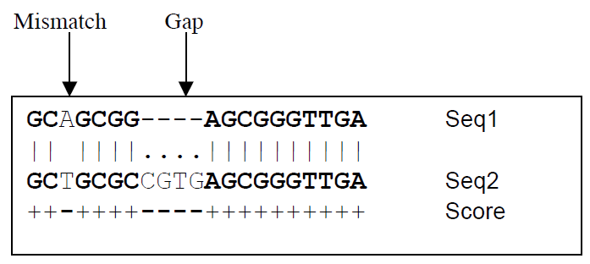
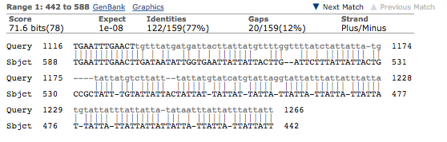
How to score alignment?
Score to find a better alignment?
Match gets + score
Mismatch –ve
Gaps also get penalty
  Opening gap penalty
  Extending gap penalty

Slide 25

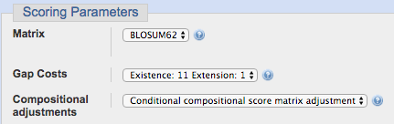
BLASTN and BLASTP Scoring
BLASTN
  Simple scoring rules like
BLASTP
  More complex matrices
    PAM (Per Cent Accepted Mutation Matrix)
    BLOSUM (Blocks Substitution Matrix) (DEFAULT)

Slide 26
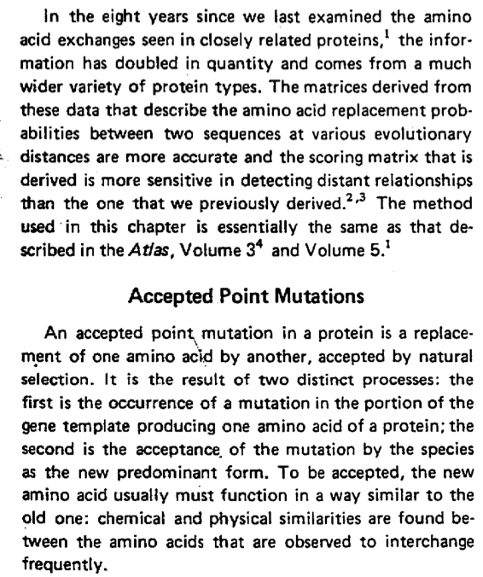
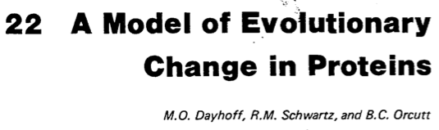
PAM - History

Slide 27
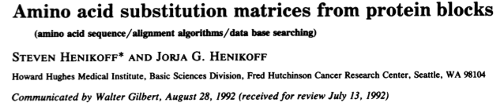
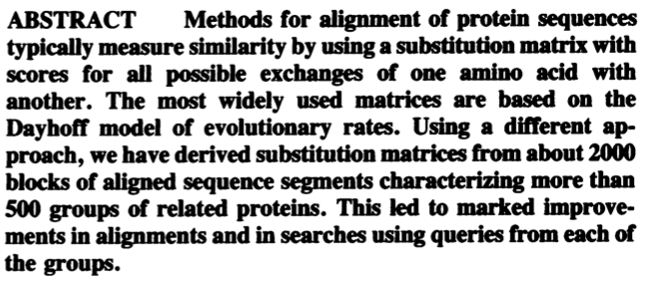
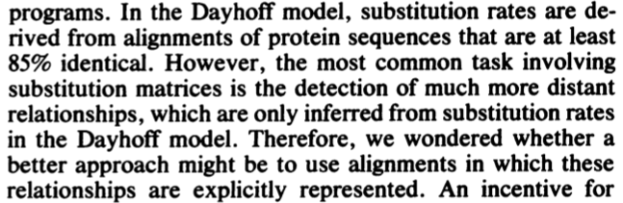
BLOSUM - History

Slide 28

How was the BLOSUM62 alignment score matrix created? (1)
The score is sum of the logarithm of the ratio of likelihoods of two hypothesis for each aligned residue
The equation for calculating score for each pair of residues is
Hypothesis 1: p_{ab} the two residues are correlated because they are homologous (target frequencies)
Hypothesis 2: f_{a} , f_{b} the likelihood of null hypothesis (background frequencies; independent)
When score is positive (p_{ab} > f_{a} f_{b}) it is an act of evolution else of chance

Slide 29
How was the BLOSUM62 alignment score matrix created? (2)
Calculate score for L/L and W/W identical pairs when p_{LL}=0.0371, p_{WW}=0.0065, f_{L}=0.099, f_{W}=0.013 and λ=0.347.
Why do you think are the L/L and W/W scores different?

Slide 30
How was the BLOSUM62 alignment score matrix created? (3)
Calculating p_{ab}
  Evolutionary distance and p_{ab}
  Recent divergence -> peak p_{ab} on identical residues
  More divergence -> flatter p_{ab} vlaues
p_{ab}’s for sequences that are 62% identical gives BLOSUM62

Slide 31
BLAST Algorithm - Working

Slide 32
BLAST Terms
Bit score
E value

